Slide 1


ICU MORTLITY CHALLENGE
Milano, XX mese 20XX
Caramaschi Sara
Donati Alice
30/05/2022
Advanced Signals and Data Processing
Riccardo Barbieri
Maximilliano Mollura

Slide 2
Data exploration
Data exploration
Check for duplicates
First dropping
Features with > 30/50% Nan
Separate features
Numerical variables
Check for Nan
Categorical variables

Slide 3
Data analysis – Numerical variables
Data visualization
See variables with first/last
Other dropping
Drop highly correlated
Plot boxplot of the variables’ distribution
Plot pairplot of the distribution (bivariate analysis)
Pearson correlation
Plot correlation heatmap
Drop highly correlated → correlation > 0.7
Check if the distribution were normal -> not normal
Check if the first/last distribution were different -> Wilcoxon Man Whitney test
Drop last if equals
Difference between the different variable distribution
Drop the two and keep the differences

Slide 4
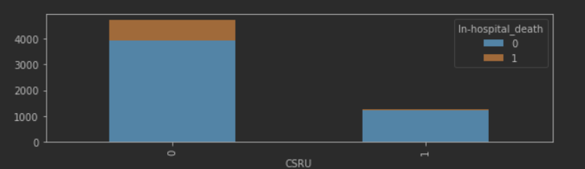
Data analysis – Categorical variables
Data visualization
Bivariate analysis
Plot histograms of variables
CSRU divided by target

Slide 5
Data preparation
Nan values
Numerical → substitute with mean
Imbalanced data
Downsampling
Train/Test
Numerical variables
Categorical → drop the rows
Categorical variables
Class weight in the model
Model training and evaluation

Slide 6
Data modelling
More than one dataset:
Data with Nan < 50% and heatmap dropping
Data with Nan < 30% and heatmap dropping
Data with Nan < 30% and Creatine log
Data with Nan < 50% and Creatine and BUN log
Tested models:
KNN
Naive Bayes
Decision Tree
Random Forest
Logistic Regression
SVM
Sequential Neural Network
Best results
with 1/2/3/4
Nome modello:
1.The minimum of Sensitivity and Precision (min(Se,Pr))
2.Area Under Precision Recall Curve (AUPRC)
3.Area Under Receiving Operating Curve (AUROC)
Anche screen volendo
Mettere anche parti di codice??????????

Slide 7
Thank you
for the attention

